Slide 1
Utility, Indifference Curve and Budget Constraint

Slide 2
The Budget Constraint
budget constraint The limits imposed on household choices by income, wealth, and product prices.
TABLE 6.1 Possible Budget Choices of a Person Earning $1,000 per Month after Taxes
Option | Monthly Rent | Food | Other Expenses | Total | Available?
A | $ 400 | $250 | $350 | $1,000 | Yes
B | 600 | 200 | 200 | 1,000 | Yes
C | 700 | 150 | 150 | 1,000 | Yes
D | 1,000 | 100 | 100 | 1,200 | No
choice set or opportunity set The set of options that is defined and limited by a budget constraint.

Slide 3
Preferences, Tastes, Trade-Offs, and Opportunity Cost
Within the constraints imposed by limited incomes and fixed prices, households are free to choose what they will and will not buy.
Whenever a household makes a choice, it is weighing the good or service that it chooses against all the other things that the same money could buy.
As long as a household faces a limited budget—and all households ultimately do—the real cost of any good or service is the value of the other goods and services that could have been purchased with the same amount of money.

Slide 4
The Equation of the Budget Constraint
In general, the budget constraint can be written
P_{X}X + P_{Y}Y = I,
where P_{X} = the price of X, X = the quantity of X consumed, P_{Y} = the price of Y, Y = the quantity of Y consumed, and I = household income.

Slide 5
The Basis of Choice: Utility
utility The satisfaction a product yields.
Diminishing Marginal Utility
marginal utility (MU) The additional satisfaction gained by the consumption or use of one more unit of a good or service.
total utility The total amount of satisfaction obtained from consumption of a good or service.
law of diminishing marginal utility The more of any one good consumed in a given period, the less satisfaction (utility) generated by consuming each additional (marginal) unit of the same good.

Slide 6
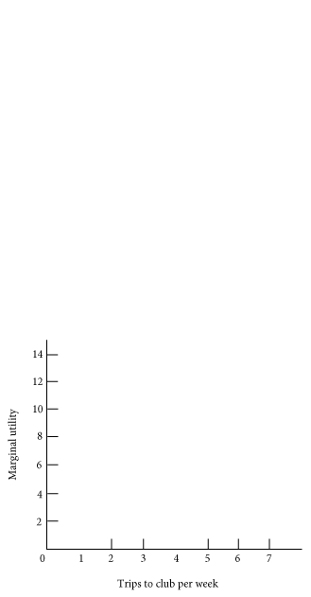
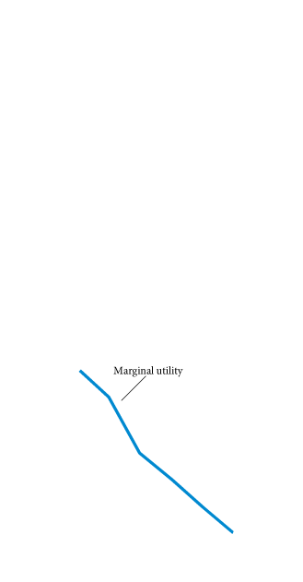
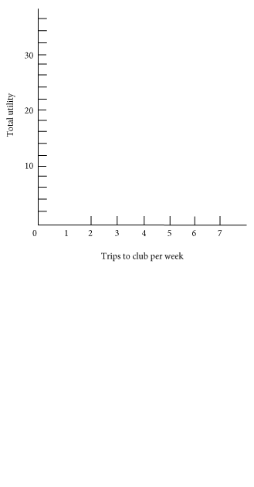
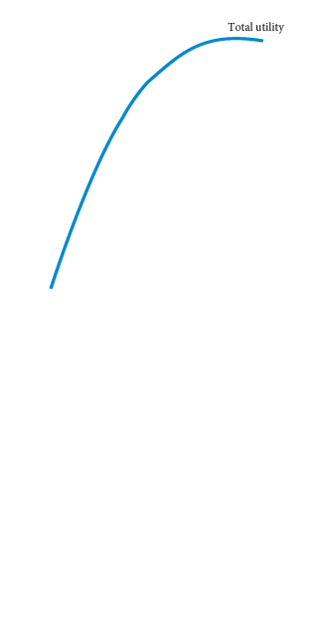
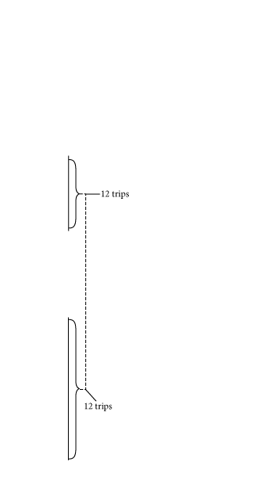
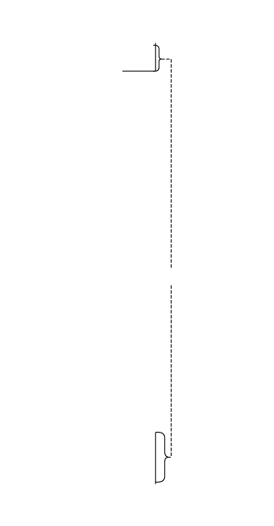


TABLE 6.2 Total Utility and Marginal Utility of Trips to the Club per Week
Trips to Club | Total Utility | Marginal Utility
1 | 12 | 12
2 | 22 | 10
3 | 28 | 6
4 | 32 | 4
5 | 34 | 2
6 | 34 | 0
④ FIGURE 6.3 Graphs of Frank’s Total and Marginal Utility
Marginal utility is the additional utility gained by consuming one additional unit of a commodity.
When marginal utility is zero, total utility stops rising.

Slide 7
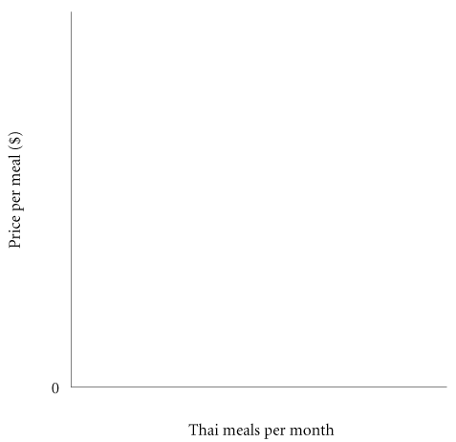
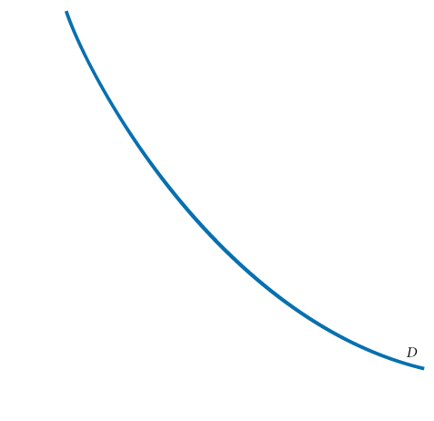
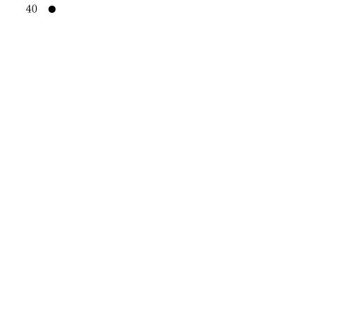
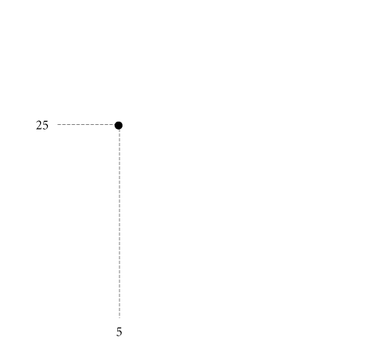
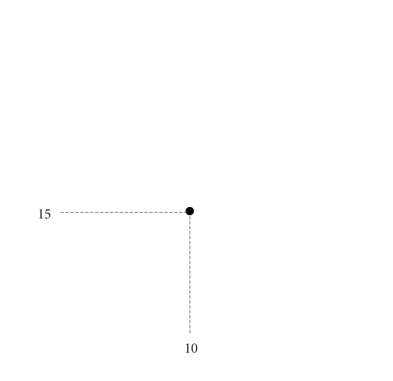

Diminishing Marginal Utility and Downward-Sloping Demand
③ FIGURE 6.4 Diminishing Marginal Utility and Downward-Sloping Demand
At a price of $40, the utility gained from even the first Thai meal is not worth the price.
However, a lower price of $25 lures Ann and Tom into the Thai restaurant 5 times a month. (The utility from the sixth meal is not worth $25.)
If the price is $15, Ann and Tom will eat Thai meals 10 times a month—until the marginal utility of a Thai meal drops below the utility they could gain from spending $15 on other goods.
At 25 meals a month, they cannot tolerate the thought of another Thai meal even if it is free.

Slide 8
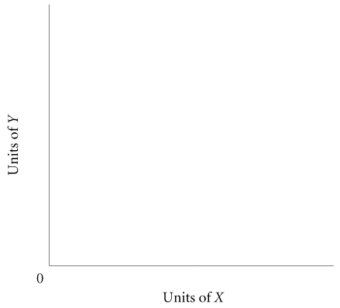
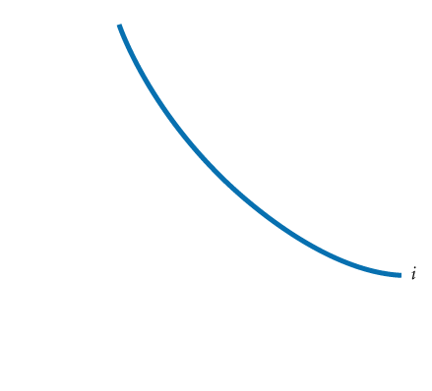
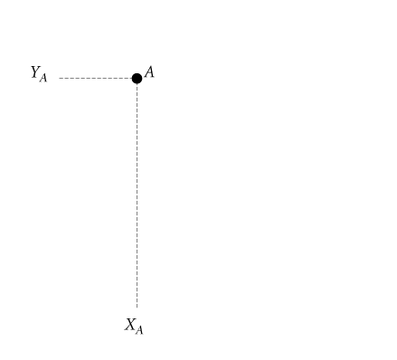
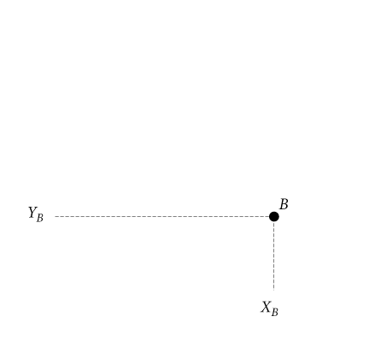
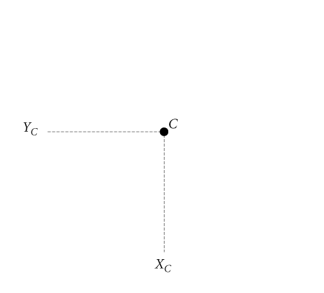
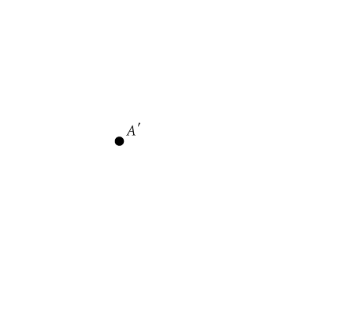
Deriving Indifference Curves
③ FIGURE 6A.1 An Indifference Curve
An indifference curve is a set of points, each representing a combination of some amount of good X and some amount of good Y, that all yield the same amount of total utility.
The consumer depicted here is indifferent between bundles A and B, B and C, and A and C.
Because “more is better,” our consumer is unequivocally worse off at A' than at A.

Slide 9
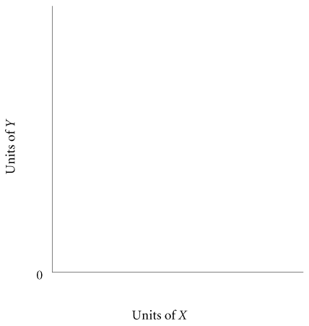
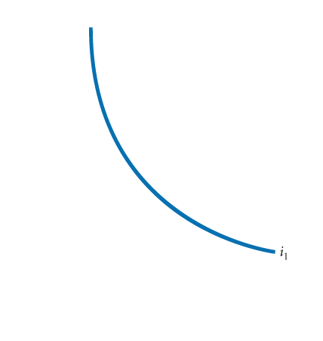
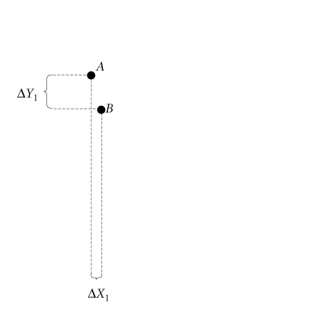
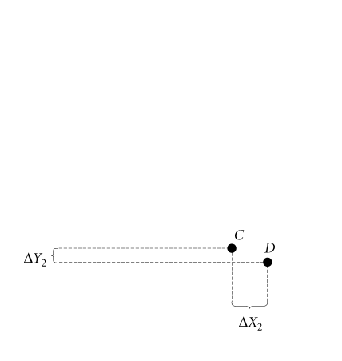
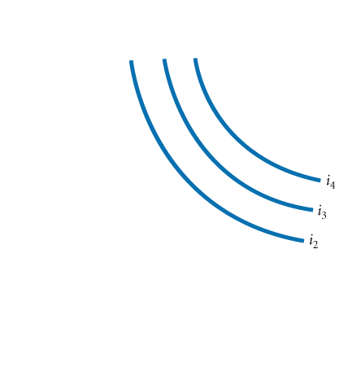
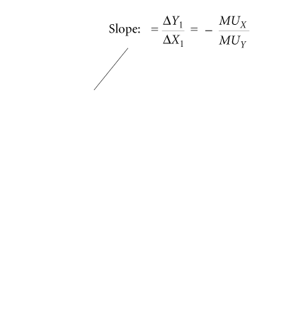
Properties of Indifference Curves
③ FIGURE 6A.2 A Preference Map: A Family of Indifference Curves
Each consumer has a unique family of indifference curves called a preference map.
Higher indifference curves represent higher levels of total utility.
When we divide both sides by MU_{Y} and by ∆X, we obtain
The slope of an indifference curve is the ratio of the marginal utility of X to the marginal utility of Y, and it is negative.

Slide 10
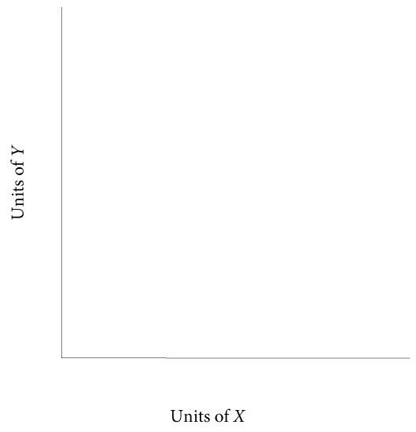
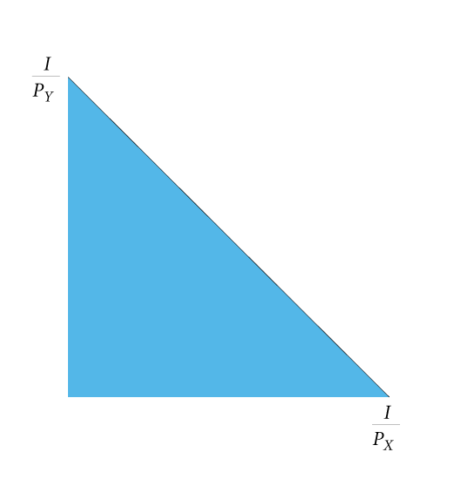
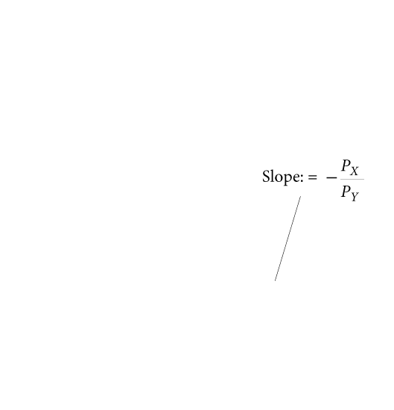
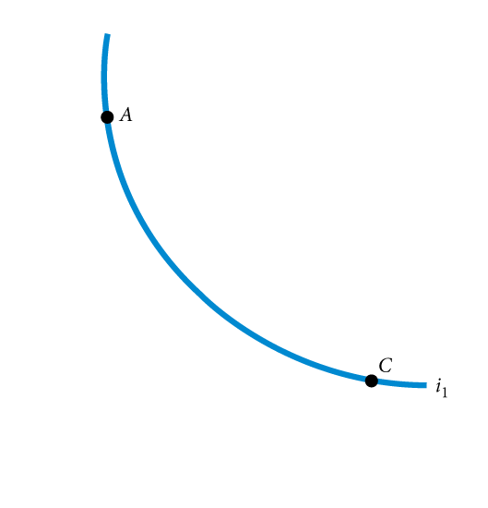
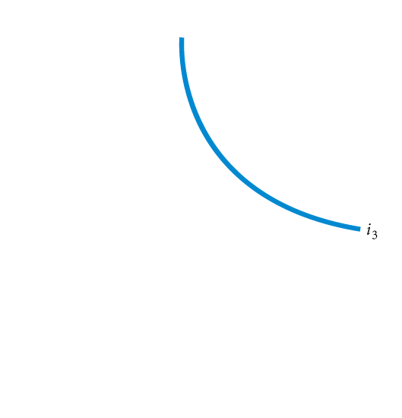
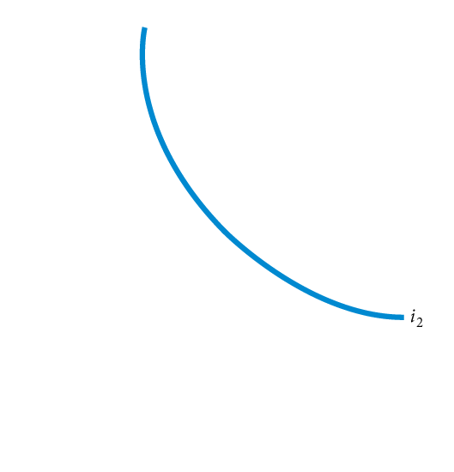
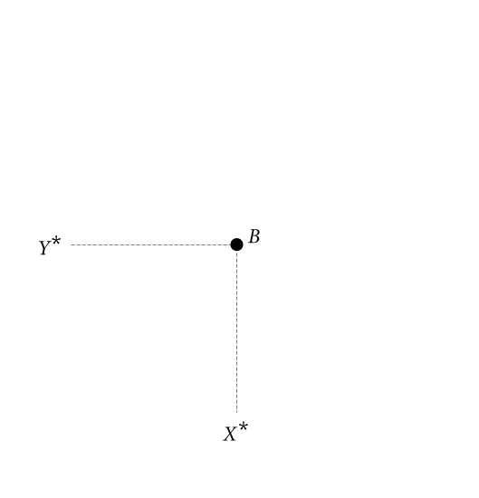
Consumer Choice
③ FIGURE 6A.3 Consumer Utility-Maximizing Equilibrium
Consumers will choose the combination of X and Y that maximizes total utility.
Graphically, the consumer will move along the budget constraint until the highest possible indifference curve is reached.
At that point, the budget constraint and the indifference curve are tangent.
This point of tangency occurs at X* and Y* (point B).
slope of indifference curve = slope of budget constraint
By multiplying both sides of this equation by MU_{Y} and dividing both sides by P_{X}, we can rewrite this utility-maximizing rule as

Slide 11
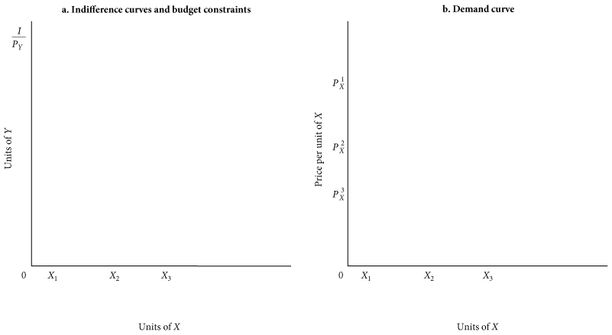
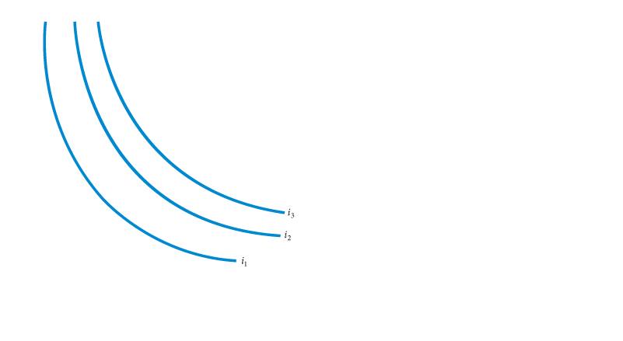
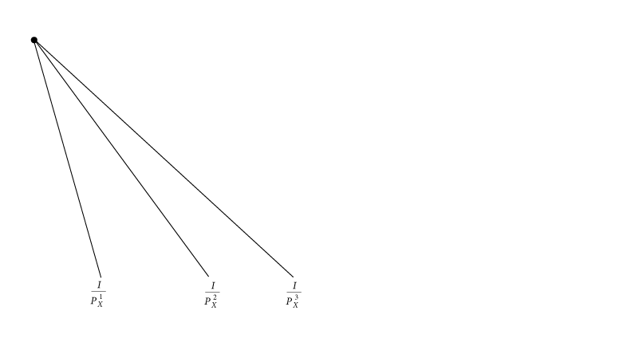
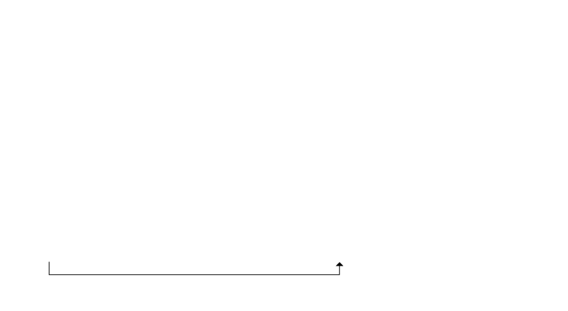

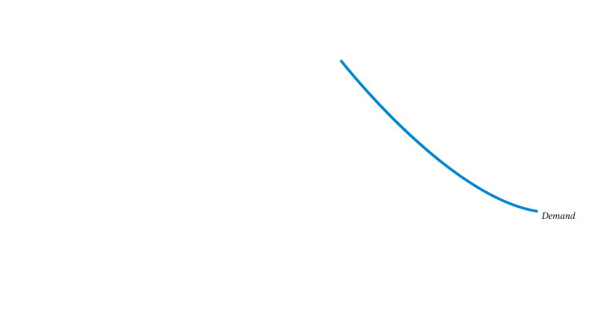
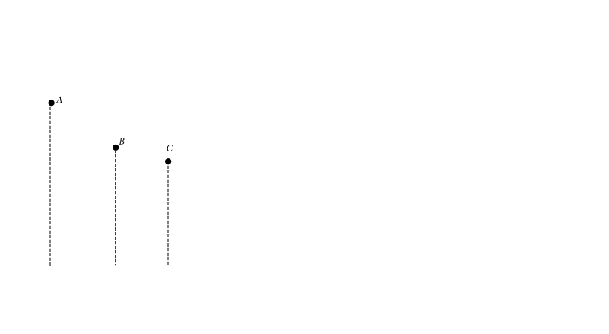
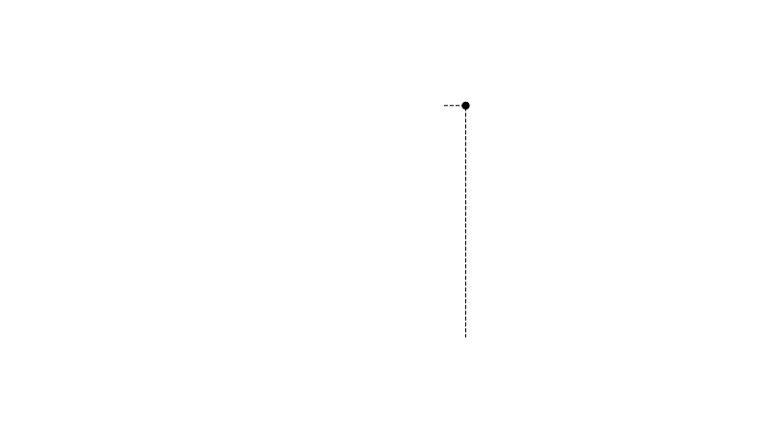
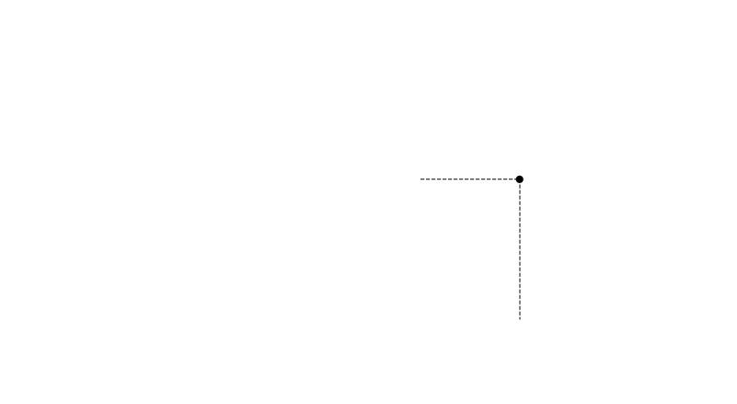
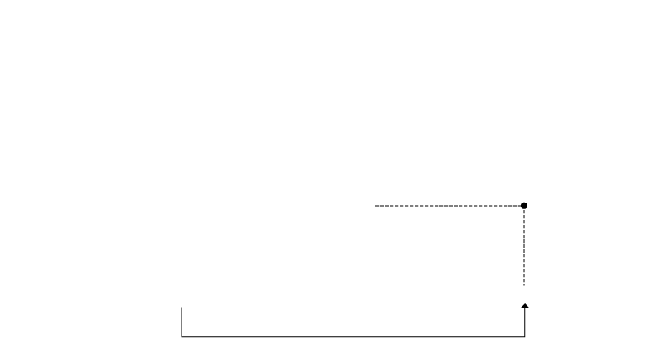
Deriving a Demand Curve from Indifference Curves and Budget Constraints
① FIGURE 6A.4 Deriving a Demand Curve from Indifference Curves and Budget Constraint
Indifference curves are labeled i₁, i₂, and i₃; budget constraints are shown by the three diagonal lines from I/P_{Y} to I/P¹_{X}, I/P²_{X} and I/P³_{X}. Lowering the price of X from P¹_{X} to P²_{X} and then to P³_{X} swivels the budget constraint to the right. At each price, there is a different utility-maximizing combination of X and Y.
Utility is maximized at point A on i₁, point B on i₂, and point C on i₃.
Plotting the three prices against the quantities of X chosen results in a standard downward-sloping demand curve.

Slide 12
A Question
Suppose the price of good X, Px = 50 and price of Y, Py = 150, the total income is 1000 which you have planned to spend on X and Y.
You have already bought 8 units of X. How many units of Y can you buy?

Slide 13
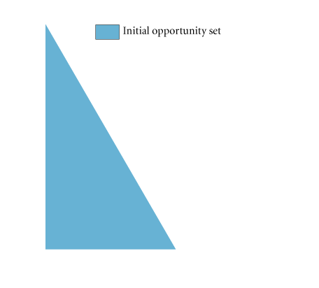
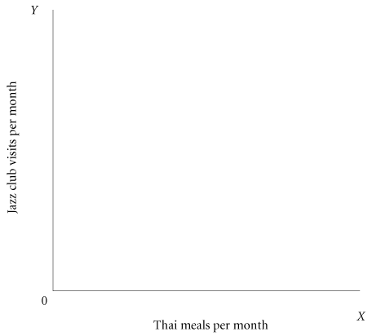
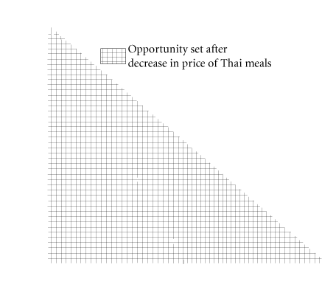
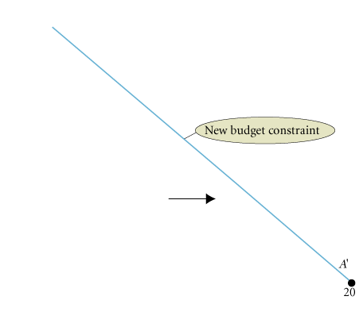
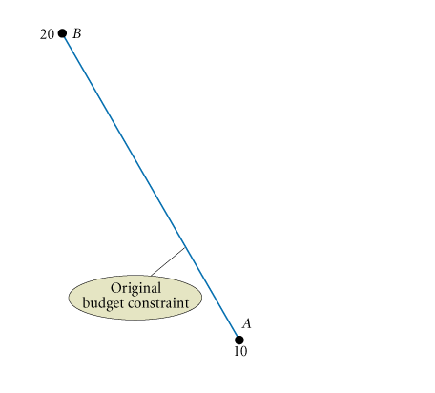
Budget Constraints Change When Prices Rise or Fall
When the price of a good decreases, the budget constraint swivels to the right, increasing the opportunities available and expanding choice.

Slide 14
The Utility-Maximizing Rule
In general, utility-maximizing consumers spread out their expenditures until the following condition holds:
where MU_{X} is the marginal utility derived from the last unit of X consumed, MU_{Y} is the marginal utility derived from the last unit of Y consumed, P_{X} is the price per unit of X, and P_{Y} is the price per unit of Y.
utility-maximizing rule Equating the ratio of the marginal utility of a good to its price for all goods.
diamond/water paradox A paradox stating that (1) the things with the greatest value in use frequently have little or no value in exchange and (2) the things with the greatest value in exchange frequently have little or no value in use.

